Slide 1

MongoDB with Python developers
Rafay itftikhar khan (Bcsm-f20-332)
Rabia khan (Bcsm-f20-349)

Slide 2
Course Contents
What is mongoDB?
How do we connect MongoDB with python application?
What is python?
How to perform crud operations in MongoDB?
How do we ۔perform aggregation functions in mongodb

Slide 3
What is mongoDB
MongoDB
MongoDB is non relational database used to store unstructured data.
Which consist of following basic things:
Fields: In mongodb fields are play same role as columns in relational database.
Documents: In mongodb documents play same role as rows in relational database.
Collection: In mongodb collections play as same role as table in relational database.

Slide 4
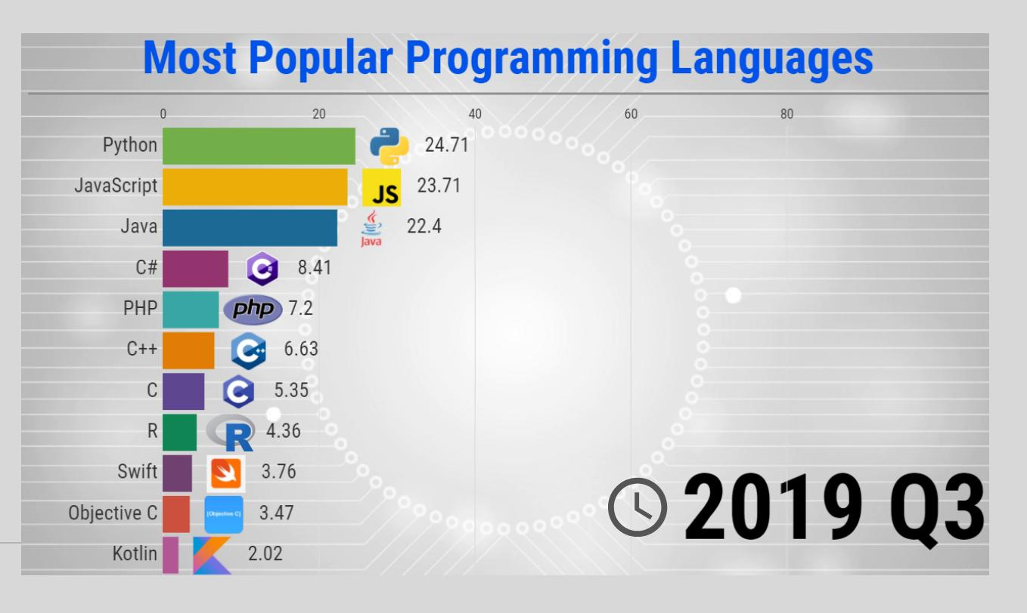
Python
Python is a computer programming language often used to build websites and software, automate tasks, and conduct data analysis.
Python is a general-purpose language, meaning it can be used to create a variety of different programs and isn’t specialized for any specific problems.
Back-end developers use the Python programming language to write data structures and algorithms to create websites. They also use Python libraries and frameworks, like Flask, Django, and NumPy.

Slide 5
MongoDB Connection
MongoDB connection with python application.
To connect mongoDB with python application some steps are performed.
Step1:
Database Drivers:
Database drivers are used to connect a python application to mongoDB database. Drivers are middleware between python application and mongoDB database. It establish secure connection to mongodb cluster and execute on behalf of client app.

Slide 6
MongoDB Driver
Pymongo one of an official mongodb driver we use as a driver to connect mongodb with python application.
Which allow use of full mongoDB development functionality.
And make upgrading easy.

Slide 7
Connecting to atlas cluster
Install pymongo for synchronous python application۔
Connect to mongoDB client instance by using connection string.
Use a single mongoDB client.
First create a directory for your project.
Create and active a python virtual environment.
Open project directory in vs code editor.
Python3 –m pip install ‘pymongo[srv]’
Now pymongo install successfully.

Slide 8
Steps for connect with mongodb a python application
From pymongo import MongoClient # Set the value of MONGODB_URI to your Atlas connection string. MONGODB_URI = ‘<your-connection-string-goes-here>’ # Connect to your MongoDB cluster. Client = MongoClient(MONGODB_URI) # List all databases in the cluster. For db_name in client.list_database_names(): print(db_name)from pymongo import MongoClient
# Set the value of MONGODB_URI to your Atlas connection string. MONGODB_URI = ‘<your-connection-string-goes-here>’ # Connect to your MongoDB cluster. Client = MongoClient(MONGODB_URI) # List all databases in the cluster. For db_name in client.list_database_names(): print(db_name)

Slide 9
MongoDB CRUD operations
Working with mongodb documents in python.
Bson: bson are binary json is a data format mongodb uses to organize data and store data.
Bson are extensions of json providing aditional features mongodb uses.
It is more secure than plaintext json which is vulnerable for json injection attacks.
Also support more data types than json.
Pymongo allow to represent bson documents as python dictionaries.
Pymongo convert automatically python data types to and from bson.

Slide 10
CRUD Operations
Insert documents in mongodb using python application.
Documents inserted in mongodb by using pymongo driver.
Two methods to insert document:
Insert_one () method
Insert_many() method

Slide 11
Insert document
Insert_one () method.
Insert a single document in mongodb insert_one() method used.
Result= collection_name.collection.insert_one(insertdata)
Inert_many()method.
Insert multiple documents in mongodb collection using single operation.
Result=collection_name.collection.insert_many(insertdata)

Slide 12
Insert_one document
"balance": 50352434,
"last_updated": datetime.datetime.utcnow(),
}
# Write an expression that inserts the 'new_account' document into the 'accounts' collection.
result = accounts_collection.insert_one(new_account)
document_id = result.inserted_id
print(f"_id of inserted document: {document_id}")
client.close()
# Get reference to 'bank' database
db = client.bank
# Get reference to 'accounts' collection
accounts_collection = db.accounts
new_account = {
"account_holder": "Linus Torvalds",
"account_id": "MDB829001337",
"account_type": "checking",

Slide 13
Insert_one document
"account_holder": "Muhammad ibn Musa al-Khwarizmi",
"account_type": "savings",
"balance": 267914296,
},
]
# Write an expression that inserts the documents in 'new_accounts' into the 'accounts' collection.
result = accounts_collection.insert_many(new_accounts)
document_ids = result.inserted_ids
print("# of documents inserted: " + str(len(document_ids)))
print(f"_ids of inserted documents: {document_ids}")
client.close()
# Get reference to 'bank' database
db = client.bank
# Get a reference to 'accounts' collection
accounts_collection = db.accounts
new_accounts = [
{
"account_id": "MDB011235813",
"account_holder": "Ada Lovelace",
"account_type": "checking",
"balance": 60218,
},
{
"account_id": "MDB829000001",

Slide 14
CRUD Operations
Querying a mongodb collection in python using pymongo.
There are two methods to querying a mongodb collection.
Find() method.
Return all documents that match a query.
Find_one() method:
Find_one() method
Find_many() method

Slide 15
CRUD Operations
Find_one() method:
Return single document if match the query and return non if not match.
Result=collectionName.collection.find_one(document_to_find)
Find_many() method:
Result=collectionName.find_many(document_to_find)

Slide 16
Querying
documents_to_find = {"balance": {"$gt": 4700}}
# Write an expression that selects the documents matching the query constraint in the 'accounts' collection.
cursor = accounts_collection.find(documents_to_find)
num_docs = 0
for document in cursor:
num_docs += 1
pprint.pprint(document)
print()
print("# of documents found: " + str(num_docs))
client.close()
# Get reference to 'bank' database
db = client.bank
# Get a reference to the 'accounts' collection
accounts_collection = db.accounts
# Query by ObjectId
document_to_find = {"_id": ObjectId("62d6e04ecab6d8e1304974ae")}
# Write an expression that retrieves the document matching the query constraint in the 'accounts' collection.
result = accounts_collection.find_one(document_to_find)
pprint.pprint(result)
client.close()

Slide 17
CRUD Operations
Updating document in python application:
There are two methods to update document in mongodb using pymongo.
Update_one() method
Update_many() method.
Db.collection.update_one(<filter>,<update>)
Filter specifies the collection
Update specifies the modification criteria.

Slide 18
Update document
Update_one()method:
To update one document at a time.
It may be updating value of existing field.
Or it may be define a new field and value.
Update one update single document that match a specified criteria.
Result=collectionName.collection.update_one(document to update,add to document)

Slide 19
Update_one()method:
# Get reference to 'bank' database
db = client.bank
# Get reference to 'accounts' collection
accounts_collection = db.accounts
# Filter
document_to_update = {"_id": ObjectId("62d6e04ecab6d8e130497482")}
# Update
add_to_balance = {"$inc": {"balance": 100}}
# Print original document
pprint.pprint(accounts_collection.find_one(document_to_update))
# Write an expression that adds to the target account balance by the specified amount.
result = accounts_collection.update_one(document_to_update, add_to_balance)
print("Documents updated: " + str(result.modified_count))
# Print updated document
pprint.pprint(accounts_collection.find_one(document_to_update))
client.close()

Slide 20
Update document
Update_many() method:
Update many documents using a single operation ۔
Result=collectionName.collection.update_many(select-collection,set-fields)

Slide 21
Update_many()method:
# Get reference to 'bank' database
db = client.bank
# Get reference to 'accounts' collection
accounts_collection = db.accounts
# Filter
select_accounts = {"account_type": "savings"}
# Update
set_field = {"$set": {"minimum_balance": 100}}
# Write an expression that adds a 'minimum_balance' field to each savings acccount and sets its value to 100.
result = accounts_collection.update_many(select_accounts, set_field)
print("Documents matched: " + str(result.matched_count))
print("Documents updated: " + str(result.modified_count))
pprint.pprint(accounts_collection.find_one(select_accounts))
client.close()

Slide 22
CRUD Operations
Deleting a document in mongodb using pymongo
There are two methods of deleting documents in mongodb using pymongo driver.
To delete a document in mongodb first find the documents you want to delete and then delete document.
Delete_one() method
Delete_many()method

Slide 23
Delete document
Delete_one() method:
To delete one document at a time delete_one method used.
Search for the document before you delete than targeting to the delete document.
Result=collectionName.collection.delete_one(document to delete)

Slide 24
Delete_one() method:
# Get reference to 'bank' database
db = client.bank
# Get a reference to the 'accounts' collection
accounts_collection = db.accounts
# Filter by ObjectId
document_to_delete = {"_id": ObjectId("62d6e04ecab6d8e130497485")}
# Search for document before delete
print("Searching for target document before delete: ")
pprint.pprint(accounts_collection.find_one(document_to_delete))
# Write an expression that deletes the target account.
result = accounts_collection.delete_one(document_to_delete)
# Search for document after delete
print("Searching for target document after delete: ")
pprint.pprint(accounts_collection.find_one(document_to_delete))
print("Documents deleted: " + str(result.deleted_count))
client.close()

Slide 25
Delete document
Delete_many() method:
To delete multiple documents on the basis of some specific condition.
First find the document to delete by using field find.
Result=collectionName.collection.delete_many(document to delete)
Remember that delete many with empty parameters delete all documents in the collection.

Slide 26
Delete_many() method:
pprint.pprint(accounts_collection.find_one(documents_to_delete))
# Write an expression that deletes the target accounts.
result = accounts_collection.delete_many(documents_to_delete)
# Search for sample document after delete
print("Searching for sample target document after delete: ")
pprint.pprint(accounts_collection.find_one(documents_to_delete))
print("Documents deleted: " + str(result.deleted_count))
client.close()
# Get reference to 'bank' database
db = client.bank
# Get a reference to the 'accounts' collection
accounts_collection = db.accounts
# Filter for accounts with balance less than $2000
documents_to_delete = {"balance": {"$lt": 2000}}
# Search for sample document before delete
print("Searching for sample target document before delete: ")

Slide 27
CRUD Operations
Transaction in mongodb using pymongo driver
Transaction:
Transaction is a group of database operations that are completed together or not at all.
Transaction are used when group of statements are related either succeed or fail together. This property known as atomicity.
Example:
Transfer money by mobile payment app.
Adding shopping cart in online shopping.

Slide 28
Transaction
Transaction in pymongo
Some steps are performed when we create a transaction in mongodb.
Callback function: We define a call back function that satisfy the sequence of operations to perform inside the transaction.
Start a client session.
Start the transaction by calling the with_transaction()method on session object.
Mongodb will automatically cancel any multi-document transaction on that runs for more than 60 seconds.

Slide 29
Transaction
# Connect to MongoDB cluster with MongoClient
client = MongoClient(MONGODB_URI)
# Step 1: Define the callback that specifies the sequence of operations to perform inside the transactions.
def callback(
session,
transfer_id=None,
account_id_receiver=None,
account_id_sender=None,
transfer_amount=None,
):
# Get reference to 'accounts' collection
accounts_collection = session.client.bank.accounts
# Get reference to 'transfers' collection
transfers_collection = session.client.bank.transfers
transfer = {
"transfer_id": transfer_id,
"to_account": account_id_receiver,
"from_account": account_id_sender,
"amount": {"$numberDecimal": transfer_amount},
}
# Transaction operations
# Important: You must pass the session to each operation
# Update sender account: subtract transfer amount from balance and add transfer ID
accounts_collection.update_one(
{"account_id": account_id_sender},
{

Slide 30
Transaction
"$inc": {"balance": -transfer_amount},
"$push": {"transfers_complete": transfer_id},
},
session=session,
)
# Update receiver account: add transfer amount to balance and add transfer ID
accounts_collection.update_one(
{"account_id": account_id_receiver},
{
"$inc": {"balance": transfer_amount},
"$push": {"transfers_complete": transfer_id},
},
session=session,
)
# Add new transfer to 'transfers' collection
transfers_collection.insert_one(transfer, session=session)
print("Transaction successful")
return
def callback_wrapper(s):
callback(
s,
transfer_id="TR218721873",
account_id_receiver="MDB343652528",
account_id_sender="MDB574189300",
transfer_amount=100,
)
# Step 2: Start a client session
with client.start_session() as session:
# Step 3: Use with_transaction to start a transaction, execute the callback, and commit (or cancel on error)
session.with_transaction(callback_wrapper)
client.close()

Slide 31
Mongodb aggregation
Mongodb aggregation functions
Aggregation: aggregation is a language for an aggregation pipeline is connected is composed of stages and expressions operators. Aggregation is language of filtering, sorting, organizing and analyzing data such as:
Finding
Sorting
Grouping
Projecting
Pipeline make it easier to debug and maintain individual stages.
It also optimize the query.
Expression operators are similar to function.

Slide 32
Aggregate pipeline
$match: $match is an aggregate function which filter all documents that match specified criteria.
Suppose you want to count number of saving accounts whose balance greater than 1000.
$match{
Account-type:’savings’,
Balance:{
$gt:1000
}}

Slide 33
$match:
# Select accounts with balances of less than $1000.
select_by_balance = {"$match": {"balance": {"$lt": 1000}}}
# Separate documents by account type and calculate the average balance for each account type.
separate_by_account_calculate_avg_balance = {
"$group": {"_id": "$account_type", "avg_balance": {"$avg": "$balance"}}
}
# Create an aggegation pipeline using 'stage_match_balance' and 'stage_group_account_type'.
pipeline = [
# Connect to MongoDB cluster with MongoClient
client = MongoClient(MONGODB_URI)
# Get reference to 'bank' database
db = client.bank
# Get reference to 'accounts' collection
accounts_collection = db.accounts
# Calculate the average balance of checking and savings accounts with balances of less than $1000.

Slide 34
$project:
select_by_balance,
separate_by_account_calculate_avg_balance,
]
# Perform an aggregation on 'pipeline'.
results = accounts_collection.aggregate(pipeline)
print()
print(
"Average balance of checking and savings accounts with balances of less than $1000:", "\n"
)
for item in results:
pprint.pprint(item)
client.close()

Slide 35
Aggregate pipeline
$project:$project aggregate function is used to specify the fields you want to see. For example you want to see only id and account Holder name in uppercase from account collection.
$project{
Id=0,
Account-holder:{
$toupper:$account-holder}}

Slide 36
Aggregate pipeline
$sort: sort all input documents and pass to the next stage in sorted order.
Sort in ascending order use 1
Sort in descending order use -1
# Connect to MongoDB cluster with MongoClient
client = MongoClient(MONGODB_URI)
# Get reference to 'bank' database
db = client.bank
# Get a reference to the 'accounts' collection
accounts_collection = db.accounts
# Return the account type, original balance, and balance converted to Great British Pounds (GBP)
# of all checking accounts with an original balance of greater than $1,500 US dollars, in order from highest original balance to lowest.
# To calculate the balance in GBP, divide the original balance by the conversion rate
conversion_rate_usd_to_gbp = 1.3

Slide 37
# Select checking accounts with balances of more than $1,500.
select_accounts = {"$match": {"account_type": "checking", "balance": {"$gt": 1500}}}
# Organize documents in order from highest balance to lowest.
organize_by_original_balance = {"$sort": {"balance": -1}}
# Return only the account type & balance fields, plus a new field containing balance in Great British Pounds (GBP).
return_specified_fields = {
"$project": {
"account_type": 1,
"balance": 1,
"gbp_balance": {"$divide": ["$balance", conversion_rate_usd_to_gbp]},
"_id": 0,
}
}
# Create an aggegation pipeline containing the four stages created above
pipeline = [
select_accounts,
organize_by_original_balance,
return_specified_fields,
]
# Perform an aggregation on 'pipeline'.
results = accounts_collection.aggregate(pipeline)
print(

Slide 38
Aggregate pipeline
$group: $group aggregate function used to separate documents into groups according to group keys. The output is one document for each unique group key۔
"Account type, original balance and balance in GDP of checking accounts with original balance greater than $1,500,"
"in order from highest original balance to lowest: ", "\n"
)
for item in results:
pprint.pprint(item)
client.close()

